Slide 1

Book Recommender System
Data Miners

Slide 2
Contents
Problem Definition
Problem Motivation
Dataset Description
EDA Results and Inferences
Current Model Choices
Final Output
Roles and Responsibilities
Challenges and Other Remarks

Slide 3
Project definition
A Recommender system is an information filtering software that suggests similar items to a User based on their earlier ‘ratings’ and ‘preferences’. Book Recommendation Systems are being used by Amazon, Barnes and Noble, Flipkart, Goodreads, etc. to recommend books the user would be tempted to buy as they are matched with user choices. To offer products and services to consumers, three types of machine learning recommendation systems based on filtering are utilized.
Content Filtering
Collaborative Filtering
Hybrid Filtering
We are building a book recommender system using a Collaborative based model. Collaborative filtering models can recommend an item to user A based on the interests of a similar user B.
A book recommendation system recommends similar books to the reader based on their interest. For instance, when a user visits the homepage, the system should recommend books based on both similarities to books the user has liked in the past and books that similar users liked. Every time a user searches for a new book, the input data is stored, and a user profile is built to get a better idea of what that user’s common search terms and interests are. Once the user profile is set up, the user’s past behavior is used, and implement a collaborative filtering system to recommend users with similar profiles, and similar books.

Slide 4
PROJECT MOTIVATION
To recommend the top 5 books KNN model using Euclidean distance will be used. Planning to create an interactive web page using HTML, CSS, Bootstrap, and Flask, and deploy using Heroku.
We also plan to build a chatbot based on Natural Language Processing (NLP) and use a recommendation engine to suggest similar books. The bot can also recommend various genres of books like Horror, Mystery, Thriller, and Fiction types - Science Fiction, Historical, Fantasy, and Realistic Fiction. It can even detect vague replies and reply accordingly.
This chatbot will be hosted on a web application. HTML, CSS, Bootstrap, and Flask will be used to take our python code and create a web application with it. Finally, it will be deployed using Heroku.

Slide 5
DATASET DESCRIPTION
We are using the 3 datasets from Kaggle.
Books.csv
The ISBN is used to identify books. Additionally, certain content-based information (Book-Title, Book-Author, Year-Of-Publication, Publisher) is provided, which was obtained from Amazon Web Services. URLs to cover photos are also provided.
Users.csv
Contains the users and user IDs (User-ID) have been anonymized and mapped to integers. Demographic data like age and location are provided.
Ratings.csv
Contains the book rating information. Ratings are either explicit, expressed on a scale from 1-10, or implicit, expressed by 0.

Slide 6
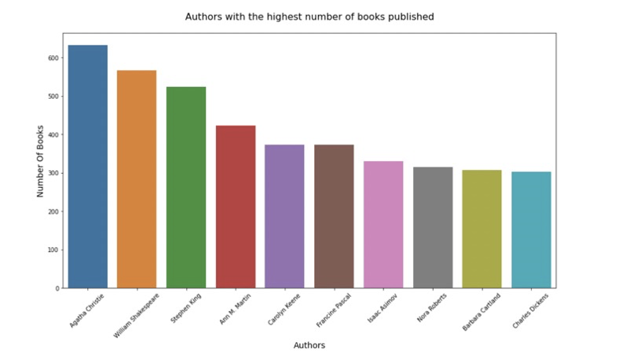
EDA RESULTS & INFERENCES
Agatha Christie published the highest number of books around 650 followed by William Shakespeare around 570 books.

Slide 7
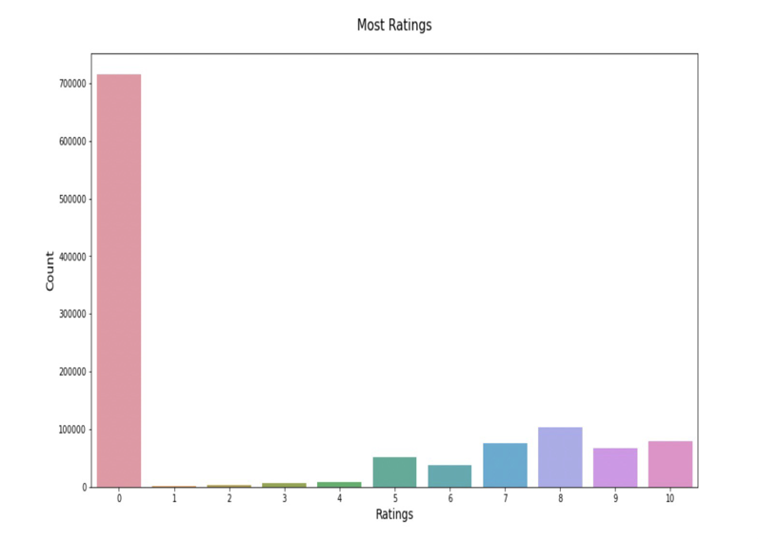
EDA RESULTS & INFERENCES
Most of the books were not rated by the users. Rating ‘8’ was given by more than 100k users.

Slide 8
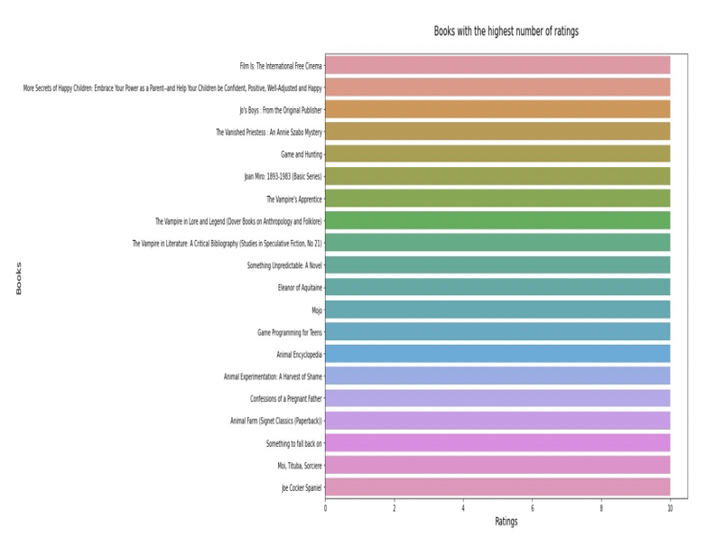
EDA RESULTS & INFERENCES
This graph represents the highest number of ratings. These shows the few of the top rated books.

Slide 9
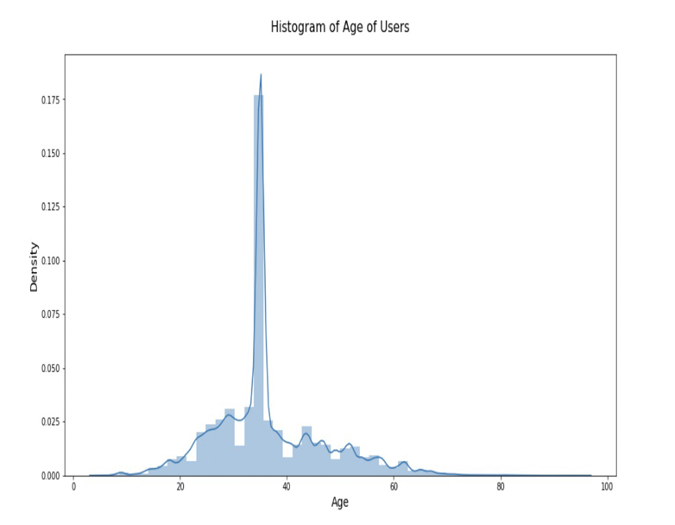
EDA RESULTS & INFERENCES
This histogram represents the age of users. We can observe that most of the users are of middle age 20 to 60 and maximum at 30’s.

Slide 10
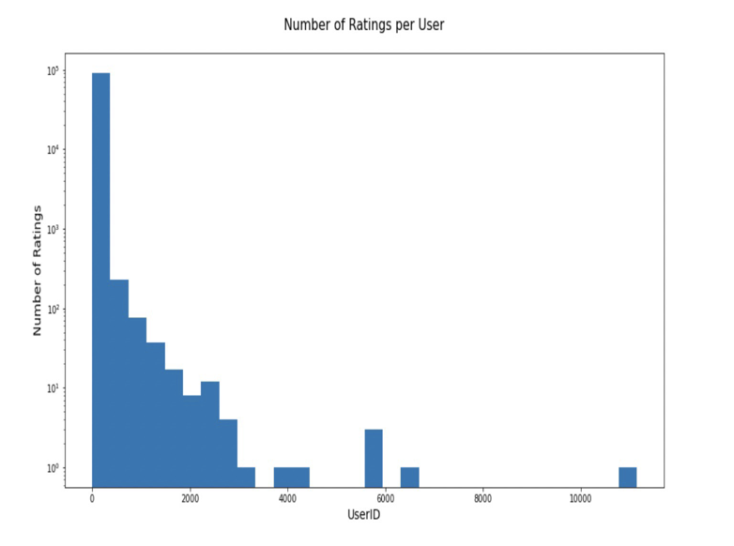
EDA RESULTS & INFERENCES
The highest number of ratings was given by the User ID between 0 and 2000. User ID's between 6400 and 10400 didn't rate any of the books or negligible.

Slide 11
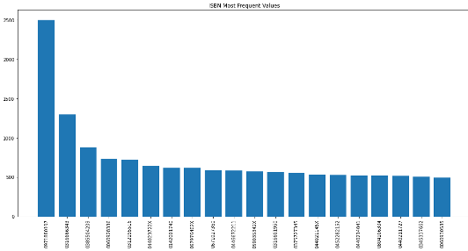
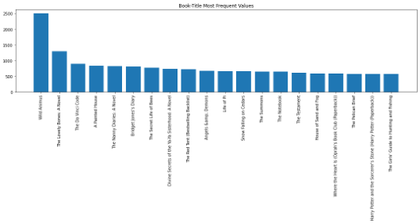
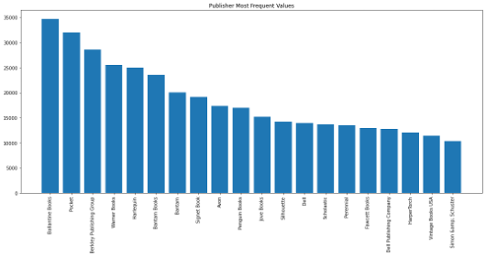
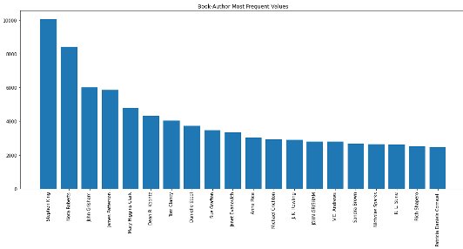
EDA RESULTS & Inferences
From this graph, we can see the top most 20 frequent values of ISBN, Book-Author, Publisher and book title. The most frequent book was with ISBN 0971880107 followed by 0316666343 and the most popular author was Stephen King followed by Nora Roberts. The most frequent publisher was Ballantine Books who published 34724 books. Wild Animus was the top most book appeared followed by The Lovely Bones.

Slide 12
CURRENT MODEL CHOICES
Why the Collaborative filtering method?
We built our Recommender system using the Collaborative filtering method. Collaborative filtering is a popular method used for RS systems that are based on information and references obtained from the users.
User rating is the most important variable for our project because it is widely used for reference in establishing our Book recommender System.
The Collaborative filtering method focuses on finding users who have given similar ratings to the same books, thus creating a link between the users, to whom we will be suggesting books for future purposes. This explains that the collaborative filtering method relies on user behavior to make recommendations.

Slide 13
CURRENT MODEL CHOICES
Why KNN ??
KNN or K-Nearest Neighbors is a simple machine learning algorithm, which tries to assign labels to new data points based on the metrics/variables we chose.
The assumption we make while choosing this algorithm is that similar data points always have similar metrics. In other words, when two data points are similar, then their position in the hyperplane is also very close to each other.
In our model, we are going to find users/books which are similar, so that we can recommend them to the user based on the input we are going to feed in the recommender system.

Slide 14
CURRENT MODEL CHOICES
Utilized pytorch to create neural network model and used natural language processing to train the chatbot.
Provided patterns and responses in form of json file and trained chabot model to answer the categories of questions.

Slide 15
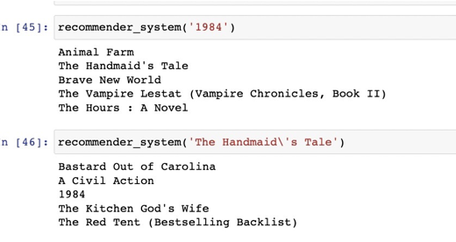
Final Output
The output of the recommender system is provided. When a book title is entered, the recommender system suggests 5 books that are similar out of 243K books.
The recommendation system will suggest only those books which have at least 50 ratings and by those users only who has rated atleast 200 times.

Slide 16
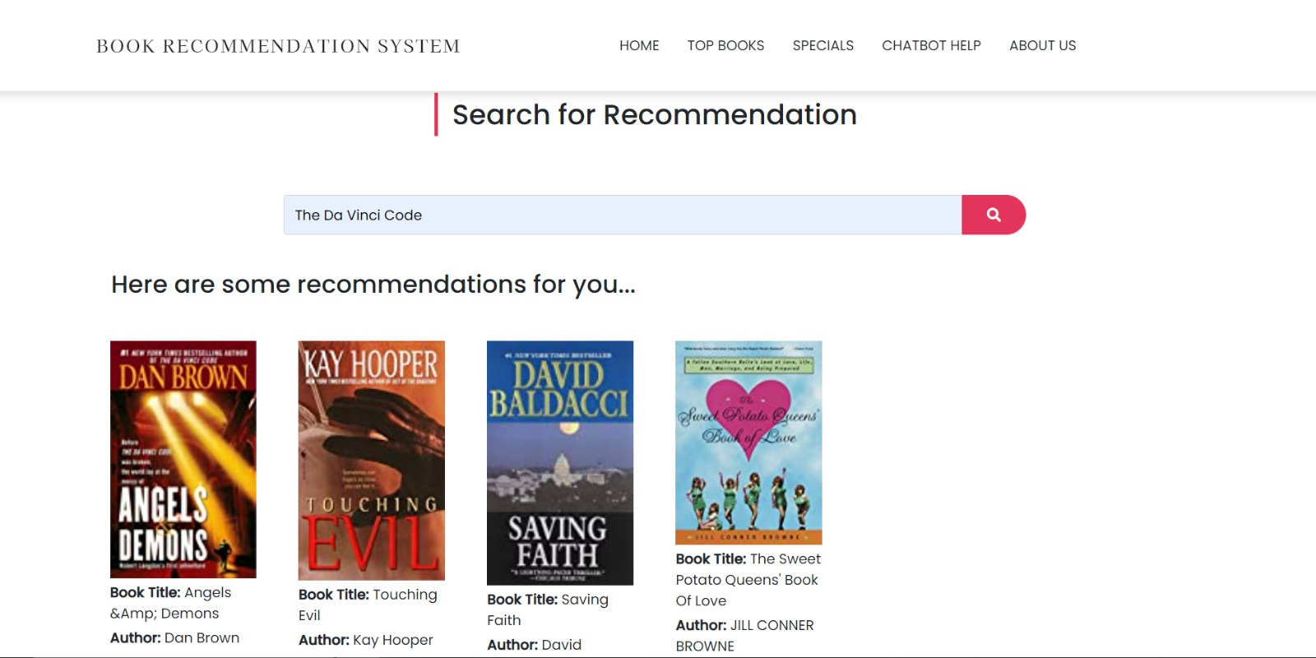
Final Output
Developed a web application by using HTML, CSS, JavaScript, Bootstrap and flask as front- end and back-end development components. Around 243K books were encountered in data set.
About website, it has some sections.
Section 1: It is about search recommendation where user will get all recommendations.

Slide 17
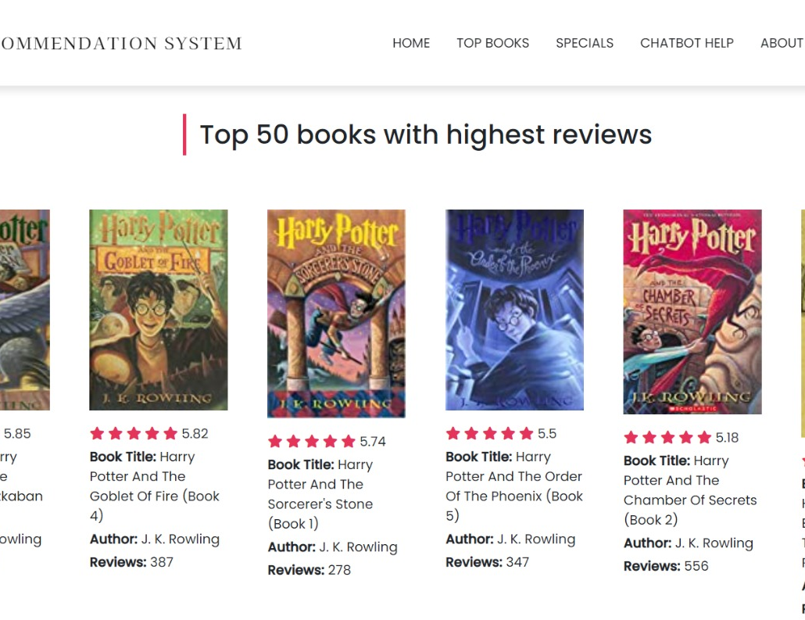
Final Output
Section 2 : This section is about Top 50 books recommended on the basis of ratings.

Slide 18
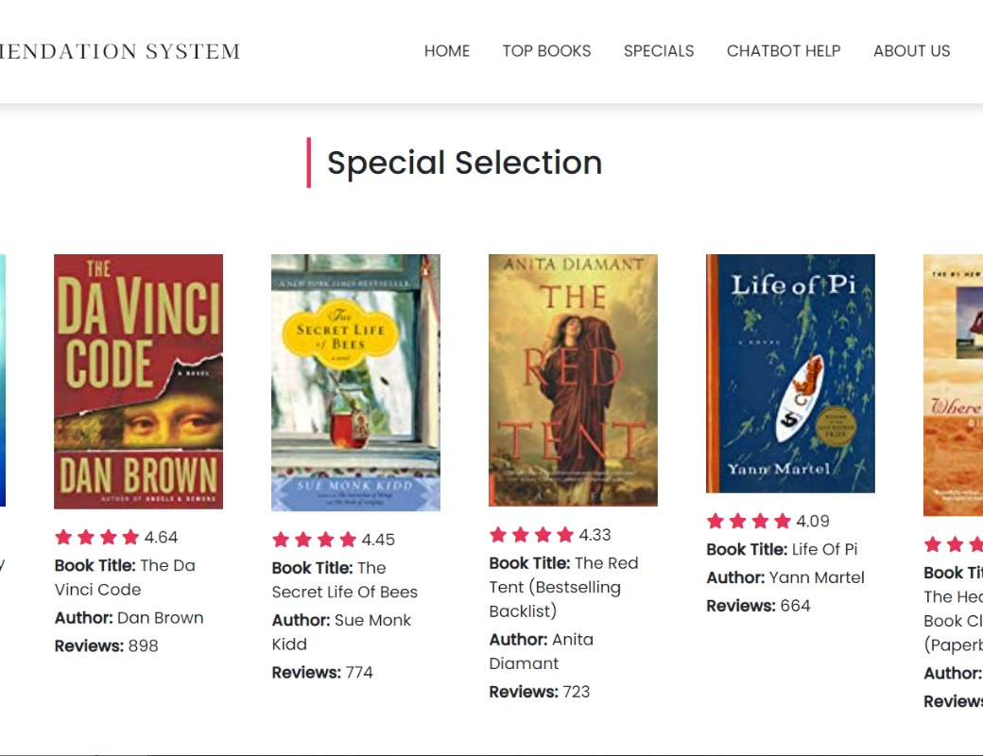
Final Output
Section 3 : It is Special Selection Section which has top 50 books recommended on the basis of reviews.

Slide 19
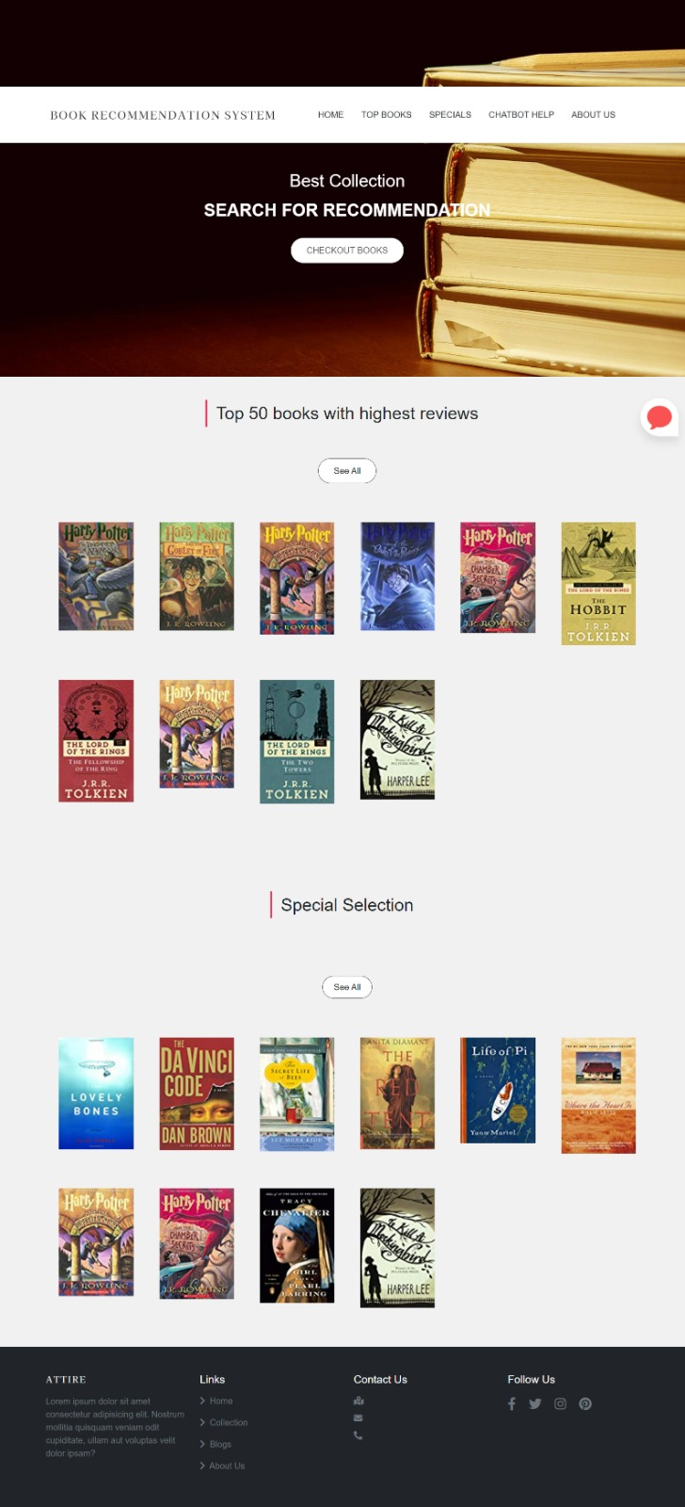
FINAL OUTPUT

Slide 20
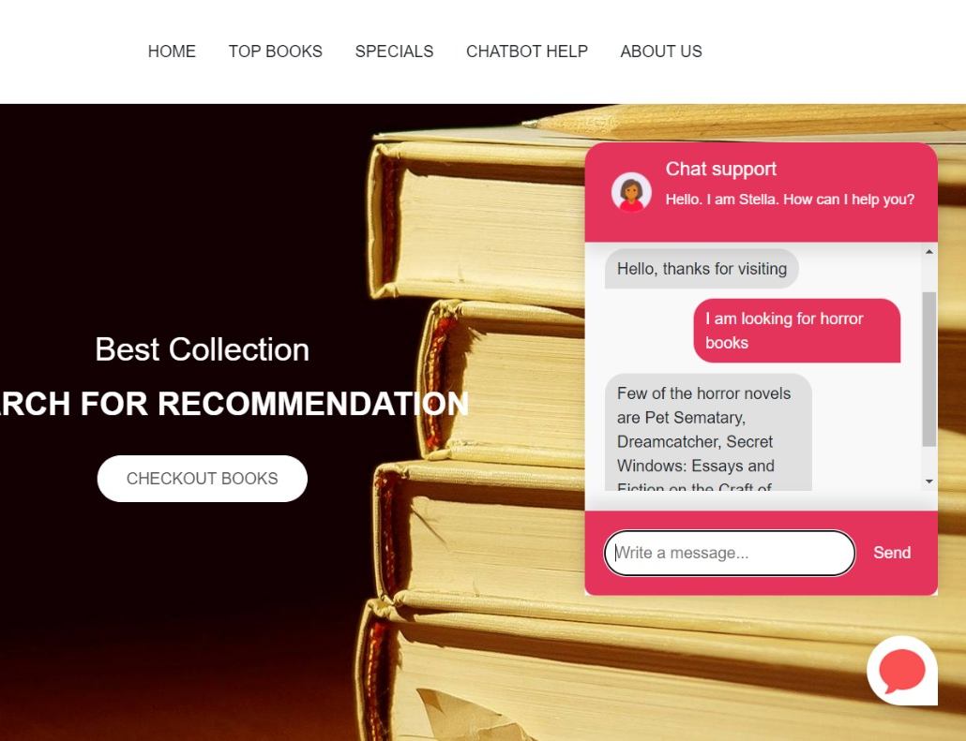
Final Output
Addition to website, we have developed a user interactive chat bot which will assist user for searching book he/she is looking for.

Slide 21
Roles and Responsibilities
Topics | Done by
Primary Report | Savitri & Sandhya
Data Cleaning & EDA | Savitri & Sandhya
PPT & Video making - WIP 1 | Meghana & Savitri
Data Preprocessing & Recommender System | Sanchit, Meghana & Hrishikesh
Web Application | Prathamesh & Harsh Vardhan
PPT & Video making - WIP 2 | Sandhya, Hrishikesh & Prathamesh
Chatbot & Integration to Web | Savitri, Sandhya & Prathamesh
PPT & Video making - Final | All

Slide 22
CHALLENGES AND OTHER REMARKS
Since the recommender system wholly depends on data, it is important that the data we use is of high quality and we should be able to analyze it properly. The dataset should be more accurate.
We decided to integrate a chatbot with our Book recommender system. It was a bit challenging, but it was a success.

Slide 23
Thank You!!

